Slide 1
Unity Shader
Lương Thanh Vũ

Slide 2
What is shader?
The program that is used to shade or contribute to shade or draw something on the screen.
Run on GPU

Slide 3
Types of Shaders
Vertex
Pixel (fragment)
Geometry
Compute
Tessellation/Hull (OpenGL 4.0/ DirectX3D11)

Slide 4
Shader in Unity
Shader Lab
Inspector
Blending Option
Passes
Hardware fallback
Cg language (Nvidia)
Surface shader
Vertex/geometry/fragment shader
Shadergraph
Cg language
Shader Lab

Slide 5
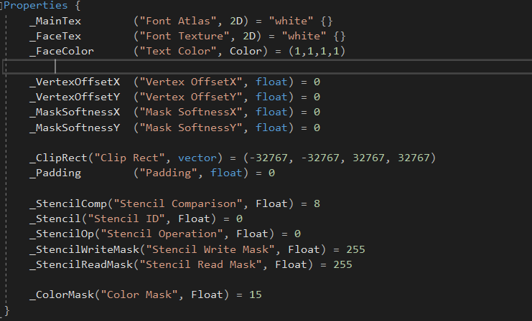
Shader in Unity
Components:
Properties
Sub shader
Sub shader
Sub shader
Hardware feature
Graphic API
Metal [iOS]
Fall back
gles
gles3
xbox360

Slide 6
Shader in Unity
Components:
Pass:
Drawcall
Vertex shader input
Vertex shader output
Vertex shader
Fragment shader
Properties
Sub shader
Pass
Pass
Fall back

Slide 7
Demo

Slide 8
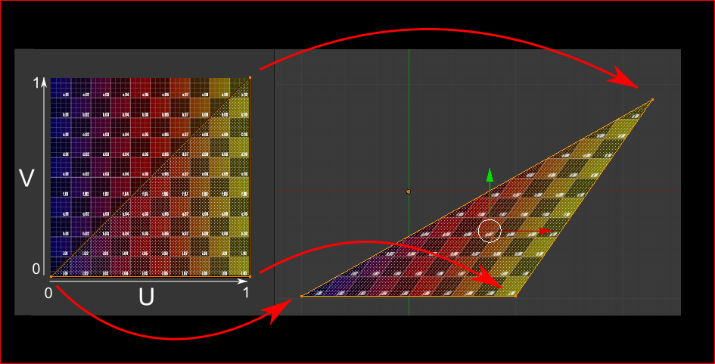
Demo
[http://www.opengl-tutorial.org/beginners-tutorials/tutorial-5-a-textured-cube/]

Slide 9
https://shaderdev.com/
https://docs.unity3d.com/Manual/SL-SurfaceShaderExamples.html
https://docs.unity3d.com/Manual/SL-UnityShaderVariables.html
https://developer.download.nvidia.com/CgTutorial/cg_tutorial_chapter01.html
https://jayjingyuliu.wordpress.com/2018/01/24/unity3d-intro-to-geometry-shader/
https://www.youtube.com/channel/UCEklP9iLcpExB8vp_fWQseg
http://wiki.unity3d.com/index.php?title=Shader_Code
https://docs.microsoft.com/en-us/windows/desktop/direct3dhlsl/dx-graphics-hlsl-semantics
https://www.shadertoy.com/
https://thebookofshaders.com/

Slide 10
Q&A

